Slide 1

MATHEMATICS FOR COMPUTNG – 4 EXTREMELY LOW BIT NEURAL NETWORK : SQUEEZE THE LAST BIT OUT WITH ADMM
DONE BY :
GROUP-4
1.ABDUL AZHAR - CB.SC.U4AIE24301
2.DEEPAK PRABHU.R - CB.SC.U4AIE24312
3.PRANESH.M - CB.SC.U4AIE24345
4.SANDHIYA.D - CB.SC.U4AIE24353

Slide 2
TABLE OF CONTENTS
SL.NO | CONTENT | SLIDE NO.
1. | INTRODUCTION | 3-5
2. | PROBLEM STATEMENT | 6
3. | OPTIMIZATION PROBLEM
4. | LAGRANGIAN
5. | UPDATE EQUATIONS
6. | DATASET DESCRIPTION
7. | COMPUTATIONAL DETAILS
8. | RESULTS
9. | REFERENCE

Slide 3
1.1 INTRODUCTION
Modern deep neural networks are accurate but extremely heavy in memory and computation, making them impractical for edge devices, embedded systems, and low-power hardware.
The main idea of this project is to compress neural networks by forcing weights to use only 1 or 2 bits (binary or ternary) instead of 32-bit floating point numbers.
If weights are only {-1, 0, +1} or {-1, +1}, then:
Multiplications can be replaced by additions and bit operations
Memory usage drops by 16× to 32×
Inference becomes much faster and energy-efficient
But naively rounding weights destroys accuracy because training neural networks with discrete constraints is a hard non-convex combinatorial optimization problem.
So the problem is reformulated as a constrained optimization problem:
Minimize loss Subject to : weights ∈ {−1, 0, +1}
This is NP-hard if solved directly.

Slide 4
1.2 INTRODUCTION
To solve this, we use ADMM (Alternating Direction Method of Multipliers) to:
Separate continuous weights (W) from
Discrete quantized weights (G)
And force them to agree gradually during training
This converts one impossible problem into three easy subproblems:
W-step: Train normal floating-point weights
G-step: Quantize weights to ternary/binary
λ-step: Penalize the difference between them
This loop slowly pushes W into the discrete set without affecting the accuracy.
The projection (quantization) step uses a mathematically optimal ternary approximation:
W ≈ α · Q, where Q ∈ {−1, 0, +1}
So, you don’t just round randomly. You optimize the scale α.

Slide 5
1.3 INTRODUCTION
The result is a network that :
Runs using almost no multiplications
Uses extremely low memory
Keeps accuracy surprisingly close to full-precision models
This project implements this ADMM-based training and demonstrates :
Float vs Ternary accuracy
Convergence behaviour
Actual ternary weight distributions

Slide 6
2. PROBLEM STATEMENT
The neural networks rely on 32-bit floating point weights, which leads to high memory usage, high bandwidth cost, and high energy consumption during inference.
For deployment on edge devices, embedded systems, and specialized accelerators, this computational and memory cost becomes the issue.
The solution is to restrict weights to extremely low precision (binary or ternary), but this introduces discrete constraints into the training process.
Training a neural network with discrete-valued parameters is fundamentally difficult because the optimization problem becomes non-differentiable (sign function).

Slide 7
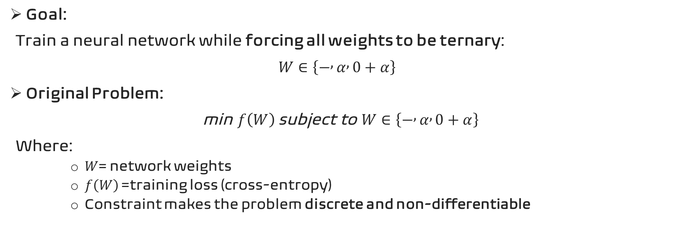
3. OPTIMIZATION PROBLEM
Goal:
Train a neural network while forcing all weights to be ternary:
$W∈\left\{− , α , 0+α\right\}$
Original Problem:
min $f\left(W\right) \text{subject} \text{to} W∈\left\{− , α , 0+α\right\}$
Where:
$W$= network weights
$f\left(W\right)$= training loss (cross-entropy)
Constraint makes the problem discrete and non-differentiable

Slide 8
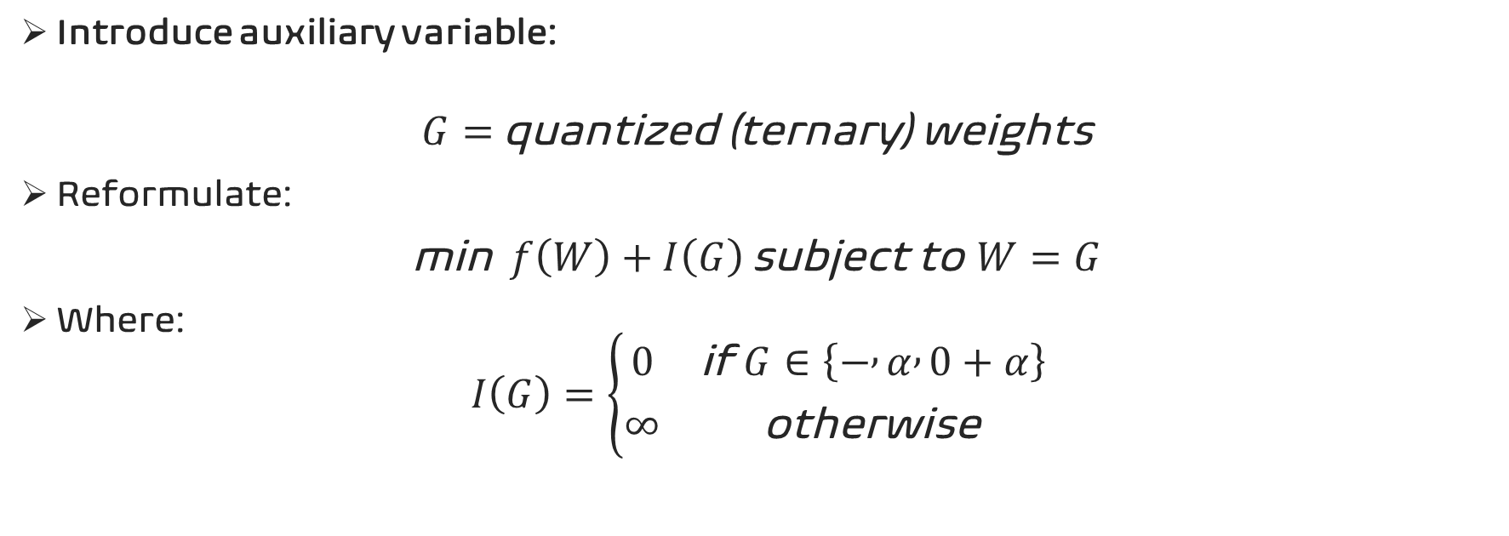
4. LAGRANGIAN EQUATION
Introduce auxiliary variable:
$$G=\text{quantized}\text{ (}\text{ternary}\text{) }\text{weights}$$
Reformulate:
min$f\left(W\right)+I\left(G\right) \text{subject} \text{to} W=G$
Where:
$$I\left(G\right)=\left\{\begin{matrix}0 & \text{if} G∈\left\{− , α , 0+α\right\} \\ ∞ & \text{otherwise}\end{matrix}\right.$$

Slide 9

5. UPDATE EQUATIONS
L(W,G,Λ)=f(W)+I(G)+2ρ​∥W−G+Λ∥2
Where:
$Λ$= dual variable (enforces constraint)
$ρ$= penalty parameter

Slide 12
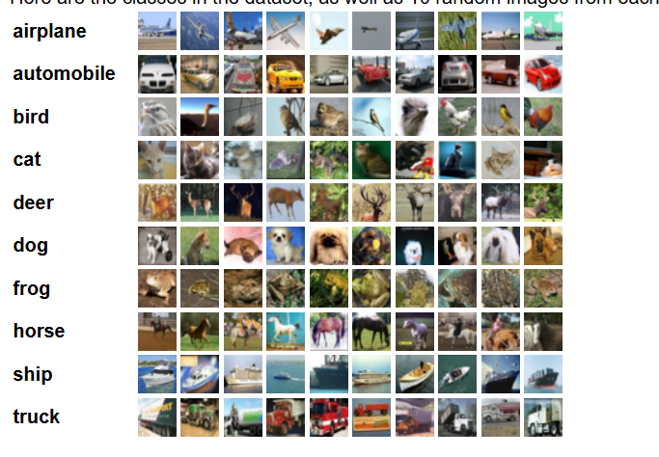
6. DATASET OVERVIEW
CIFAR-10 Dataset
Instances: 60,000 images
Image Size: 32×32 pixels
Channels: 3 (RGB)
Classes: 10
Training Images: 50,000
Test Images: 10,000
Training Batches: 5 (10,000 images each)
Test Batch: 1 (1,000 images per class)
Class Labels:
Airplane, Automobile, Bird, Cat, Deer, Dog, Frog, Horse, Ship, Truck

Slide 13
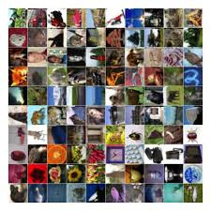
CIFAR-100 Dataset
Instances: 600 images
Image Size: 32×32 pixels
Channels: 3 (RGB)
Classes: 100
Training Images: 50,000
Test Images: 10,000
Training Batches: 5 (10,000 images each)
Test Batch: 1 (1,000 images per class)
Class Labels:
Airplane, Automobile, Bird, Cat, Deer, Dog, Frog, Horse, Ship, Truck

Slide 14
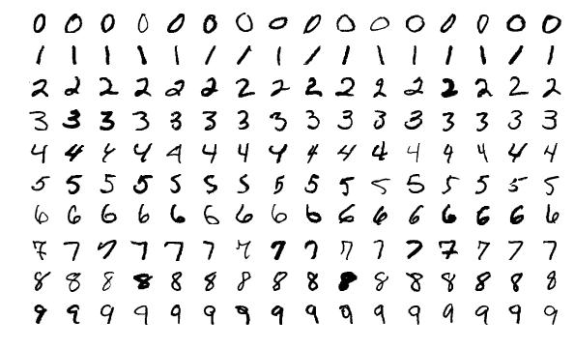
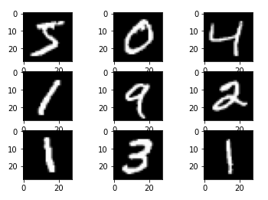
MNIST dataset
Instances: 70,000 images
Image Size: 28×28 pixels
Channels: 1 (Grayscale)
Classes: 10 (Digits 0–9)
Training Images: 60,000
Test Images: 10,000
Pixel Range: 0 to 255 (intensity)
Class Labels
Digits: 0, 1, 2, 3, 4, 5, 6, 7, 8, 9

Slide 15
NOTATIONS

Slide 16
COMPUTATIONAL DETAILS

Slide 17
RESULTS
(IN PYTHON and MATLAB)

Slide 18
PYTHON (Jupyter Notebook)

Slide 19
MATLAB

Slide 20
CONCLUSION

Slide 21
REFERENCES

Slide 22
THANK YOU

